Slide 1
PROG6212_PoePart3
This is a presentation based on lectures feedback and new features for Part 3 Poe

Slide 2
Introduction
The BuildTrack Claim System is a web-based application designed to streamline and manage the end-to-end workflow of construction work claims. It provides a centralized platform for Workers, Project Managers, Construction Managers, and HR to collaborate efficiently. Workers can submit completed jobs and track their claims, while Managers and HR can review, approve, reject, and finalize payments in a structured and automated workflow. By integrating role-based access, automated notifications, and reporting functionalities, the system reduces administrative overhead, minimizes errors, and ensures transparent and accountable management of work claims. Additionally, the application leverages a SQL database to store all work submissions, approvals, and payment records securely, ensuring data integrity and easy access for reporting and analysis.

Slide 3
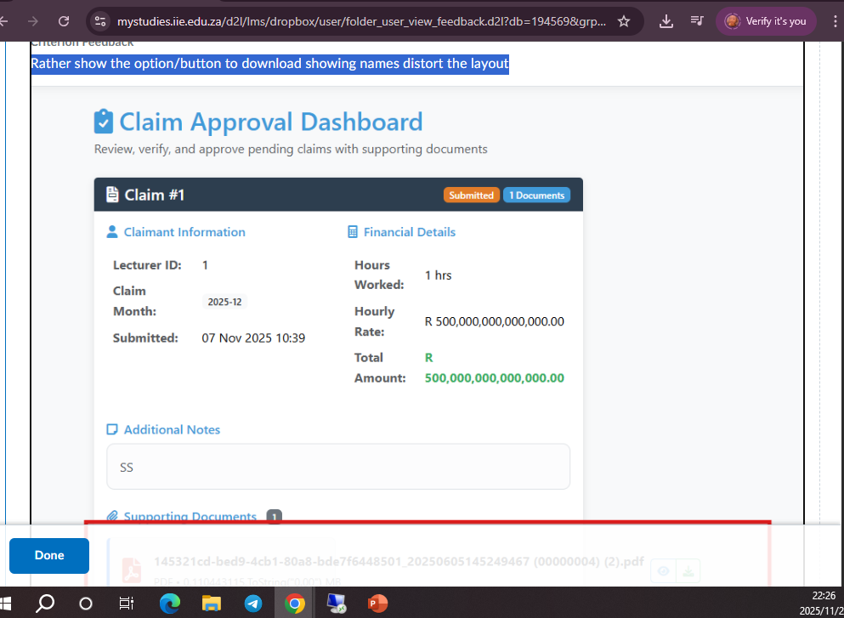
Claim Approval Dashboard
Lectures feedback(Rather show the option/button to download showing names distort the layout)
What I did about it: The whole idea if downloading proof has been removed.

Slide 4
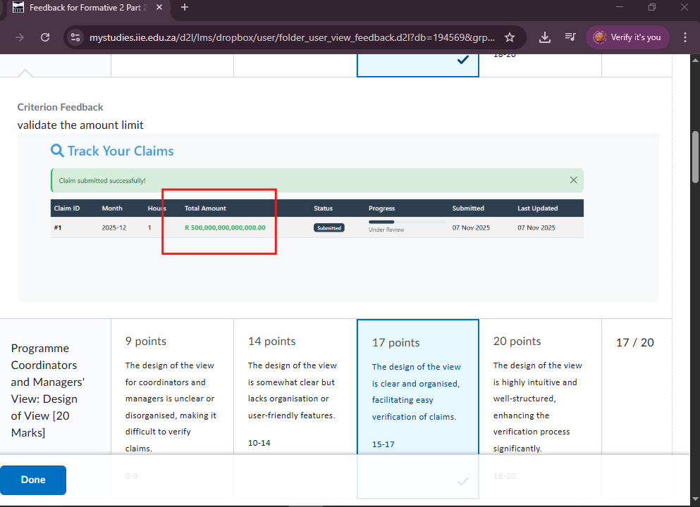
Amount Limitation
Lecture Feedback: Validate the amount limit
What I have done about it: On Part 3, the maximum hours a lecture can work is 66 Hours in a month and there is a fixed hourly rate.

Slide 5
New Features on Part 3 Poe compared to Part 2 Poe

Slide 6
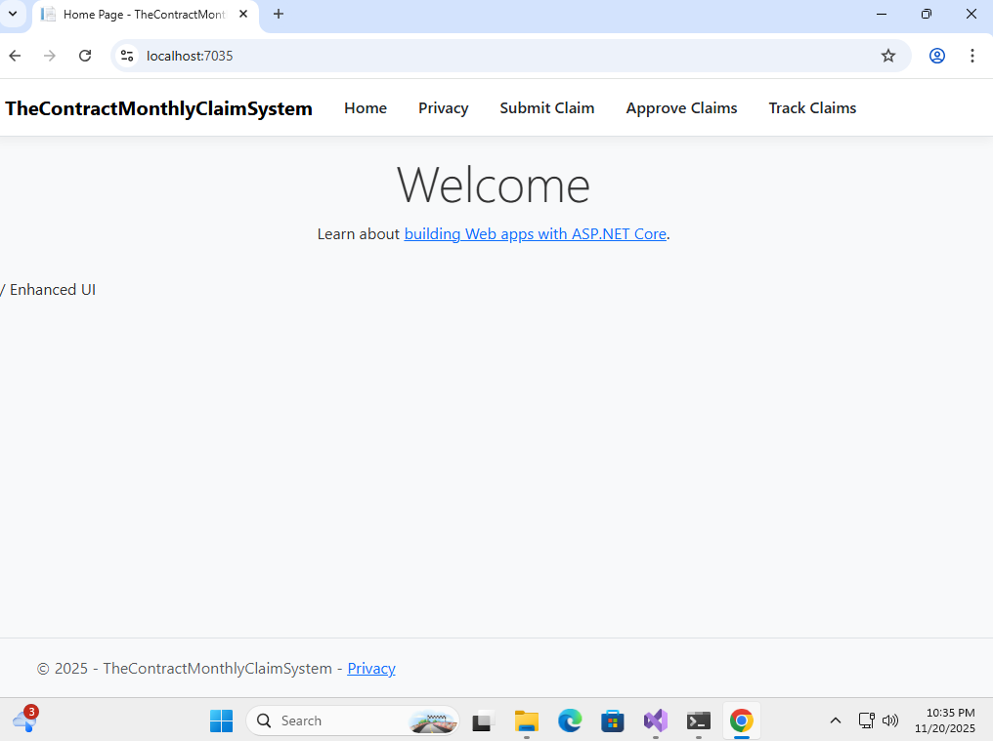
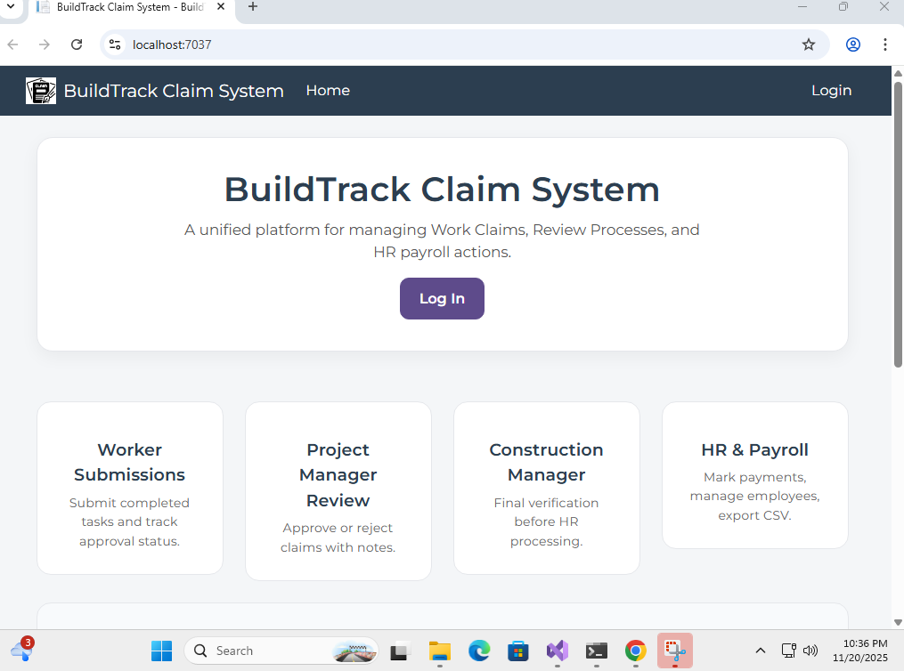
The Welcome Page
POE Part 2 had a blank Welcome Page
Poe Part 3 has a more user-friendly welcoming Page with a lot of details guiding a user on how to correctly use the application

Slide 7
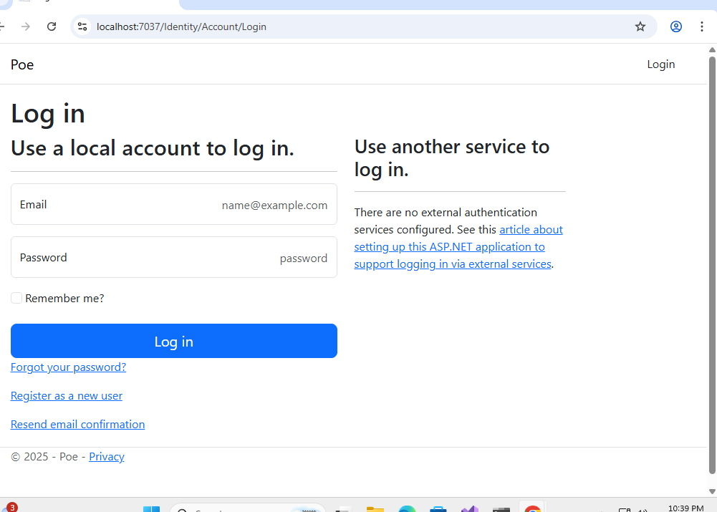
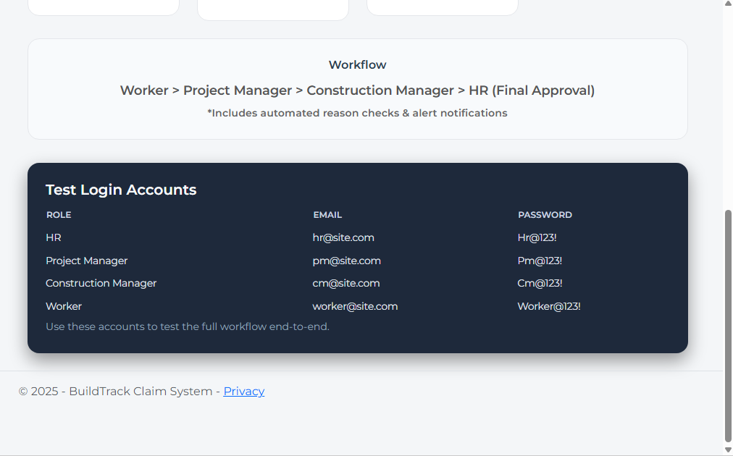
Login Feature: Part 2 had no login feature there for Part 3 has a new feature whereby users need to login depending on their position

Slide 8
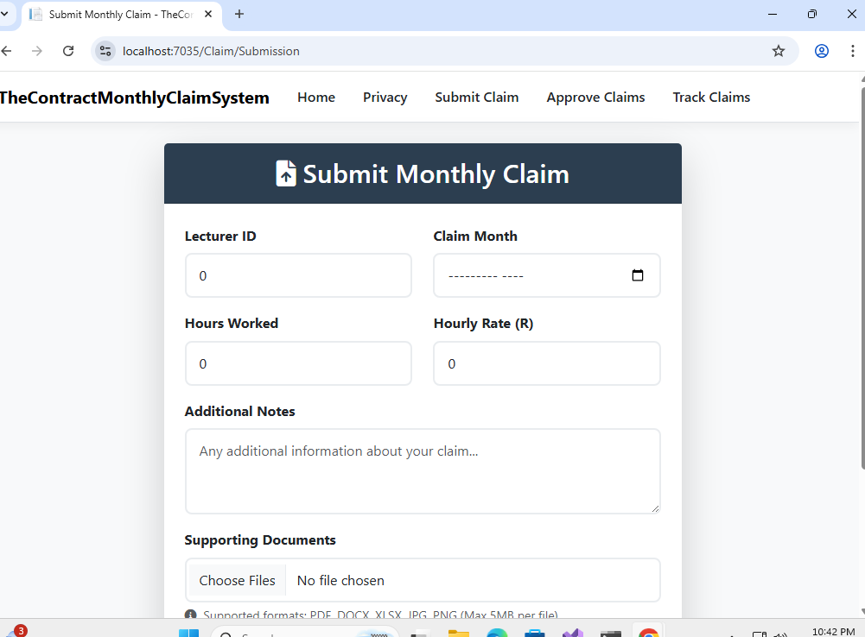
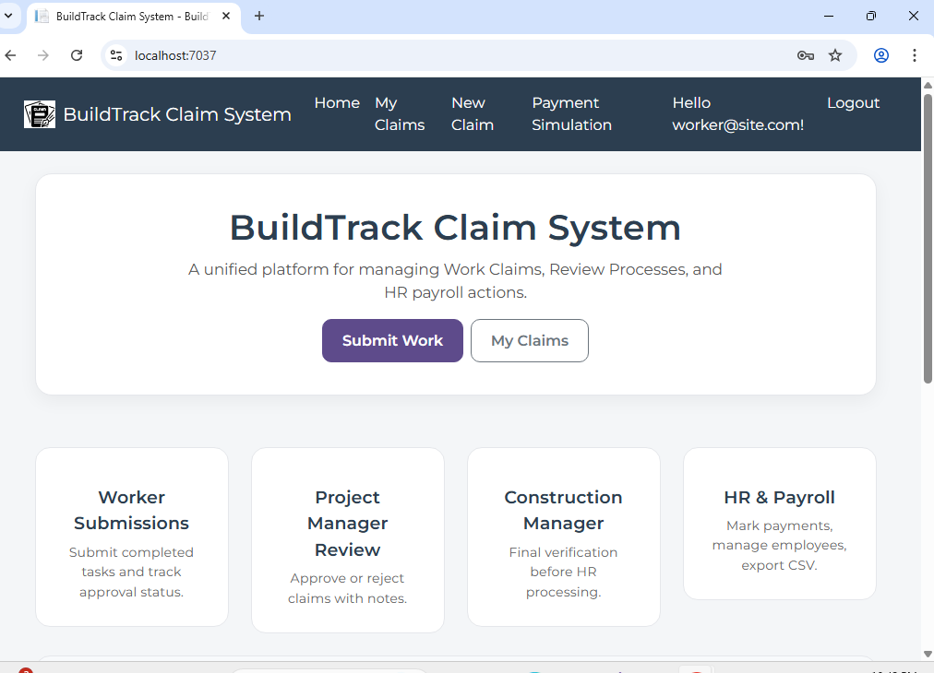
Lecture Claim
Part 2, the lecture just has to enter there details and submit proof of something for their claim to be submitted
On part 3: The lecture has a lot of updated features including the Home Page

Slide 9
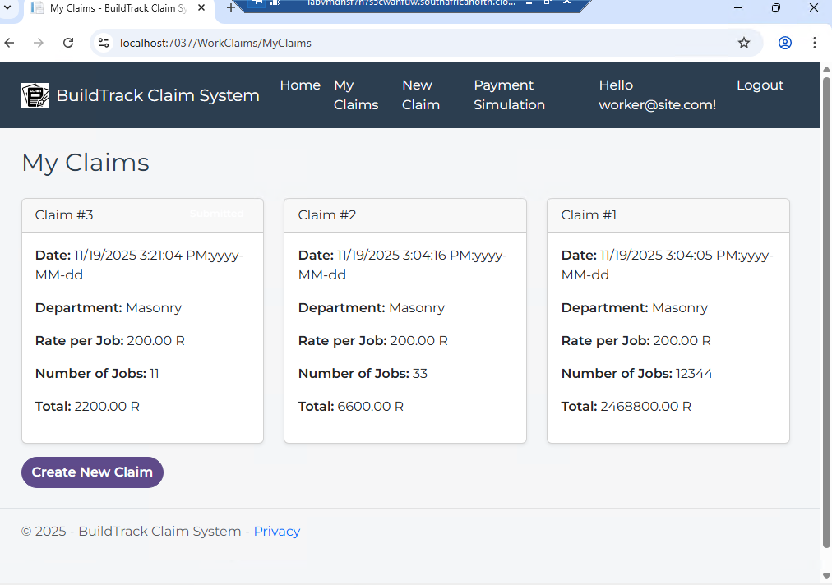
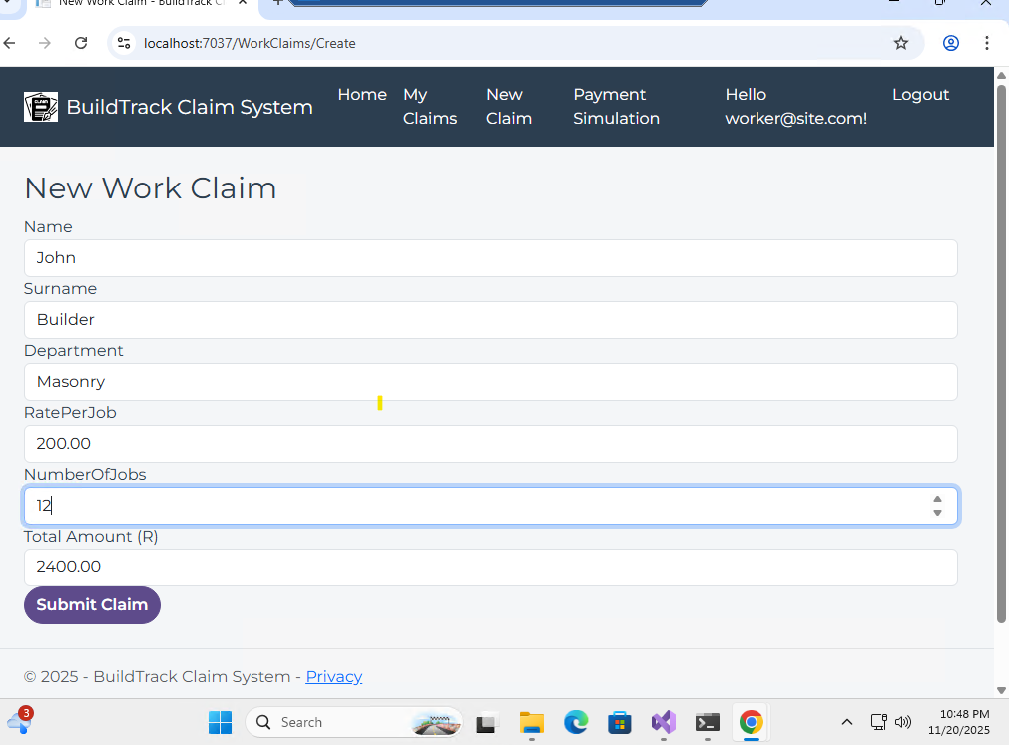
Lecture Claim (Continuation Part 3)
POE Part 3 has “MY Claim” records that show you all the claims you have made
POE Part 3 has a my “New Claim” option that already has your details and you just need to enter the umber of jobs and it will automatically calculate the amount you should get

Slide 10
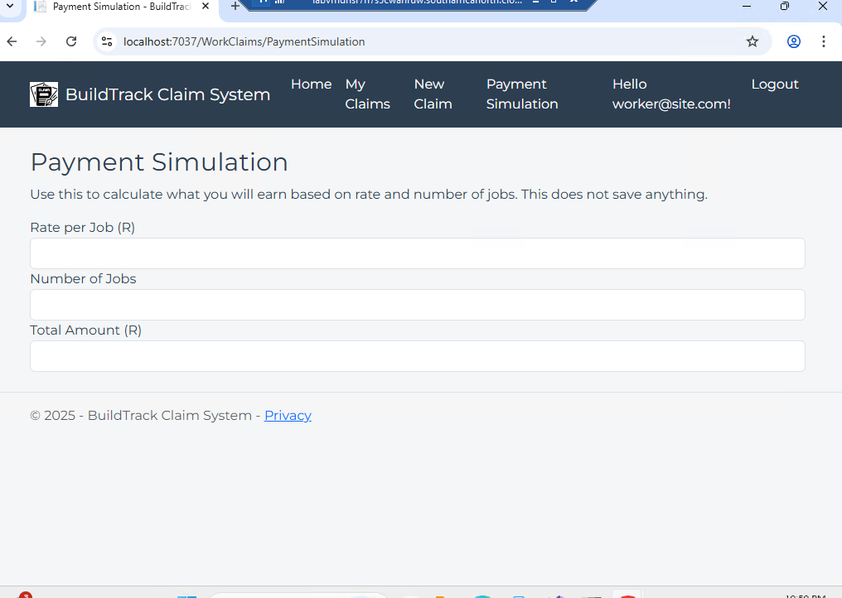
“Payment Simulation”
This is a new feature that a lecture can use to calculate the rate per job, Number of jobs and it will calculate the total amount automatically

Slide 11
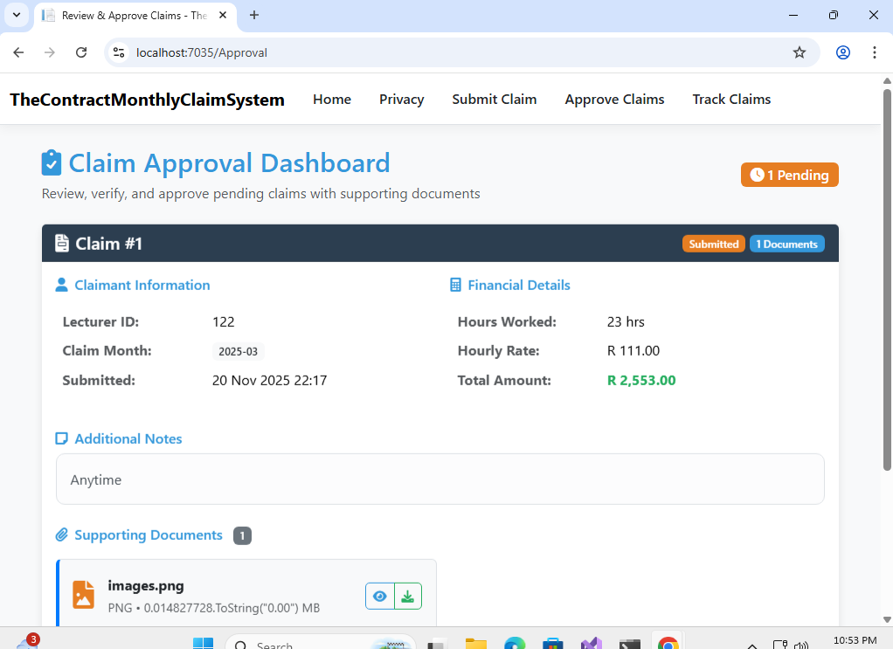
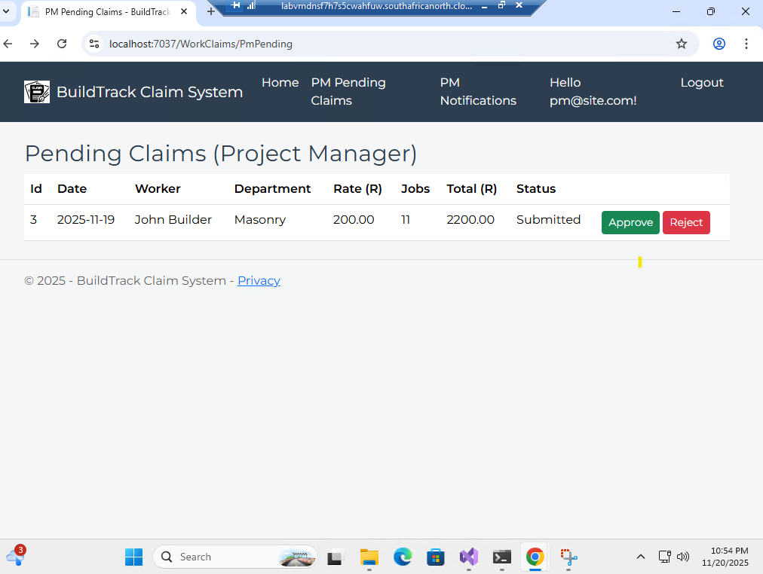
Project Manager Feature
In Poe Part 2, there was no project manager login details therefore the project manage could just reject or accept the claim
In Poe Part 3, there is a project manager profile whereby they have to approve or reject the lectures claim

Slide 12
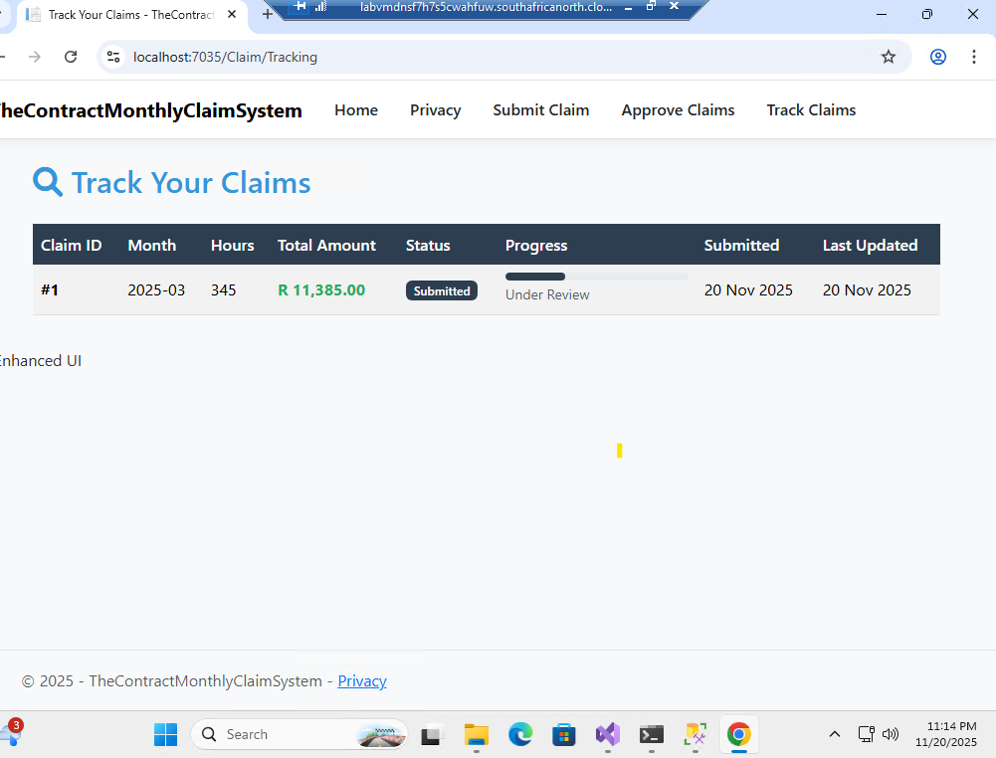
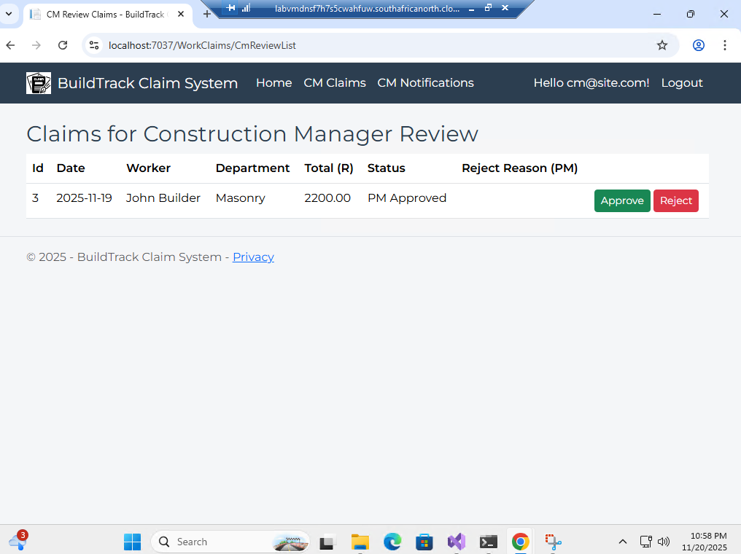
Construction Manger
There was no Construction Manager in Poe Part 2 but you could track the status
The Construction Manger is the final approver for the lectures claim!

Slide 13
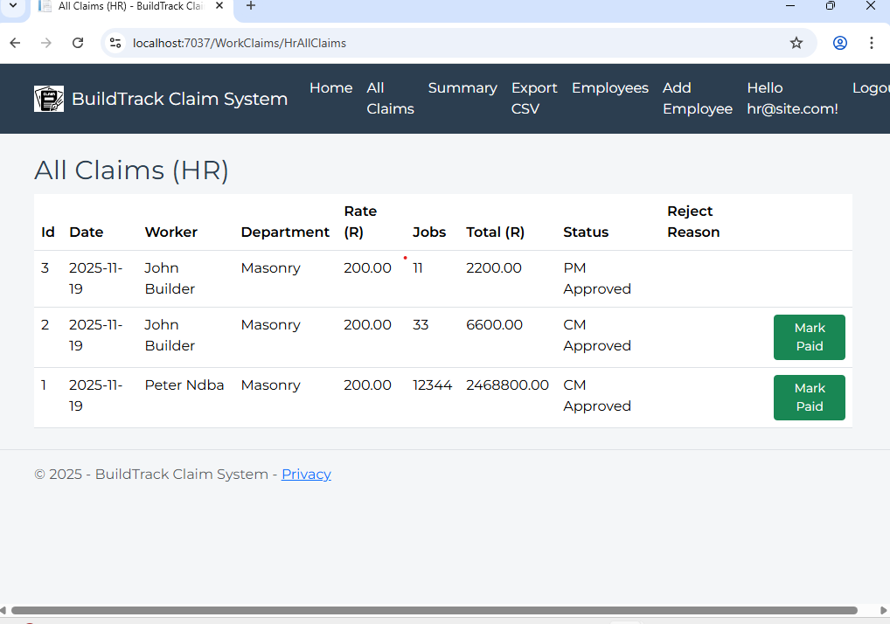
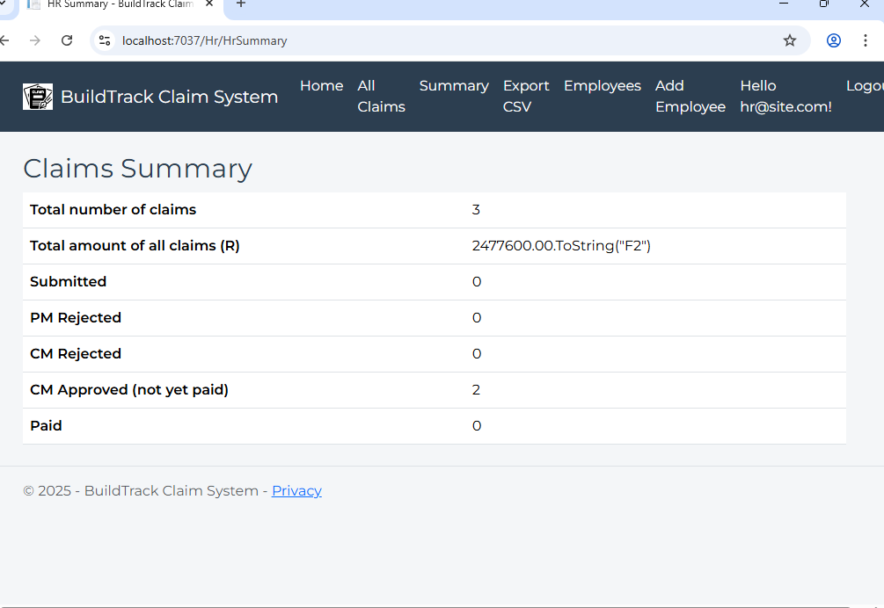
HR (New Feature)
POE Part 3 has a HR feature whereby they can view all claims made
They can view Claims Summary

Slide 14
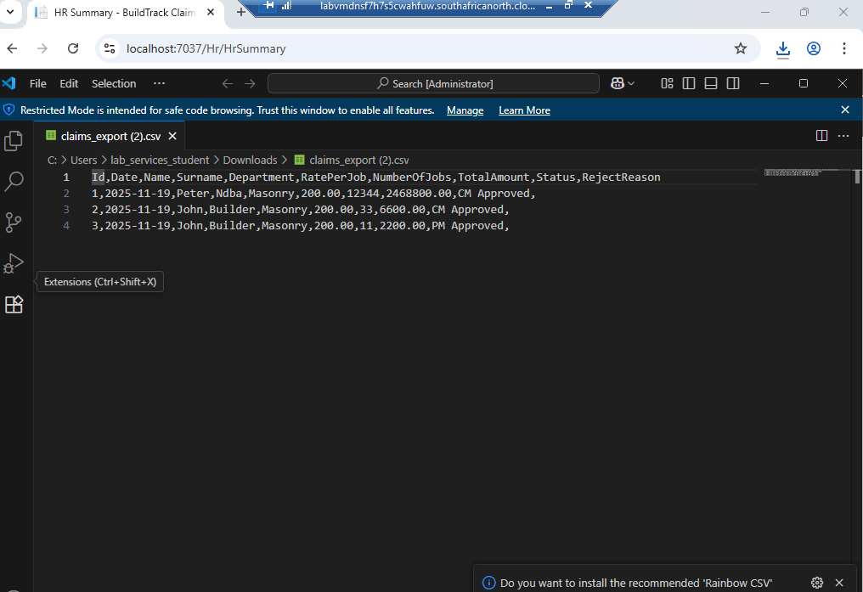
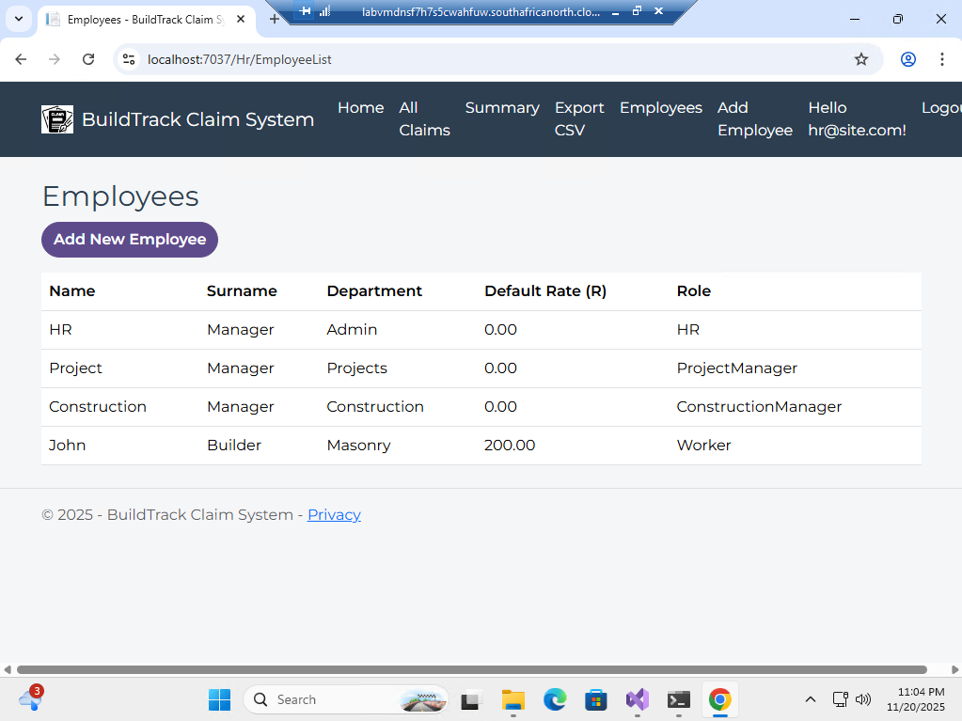
HR Feature
A CSV Report can be downloaded under the HR Feature
They can view Employees

Slide 15
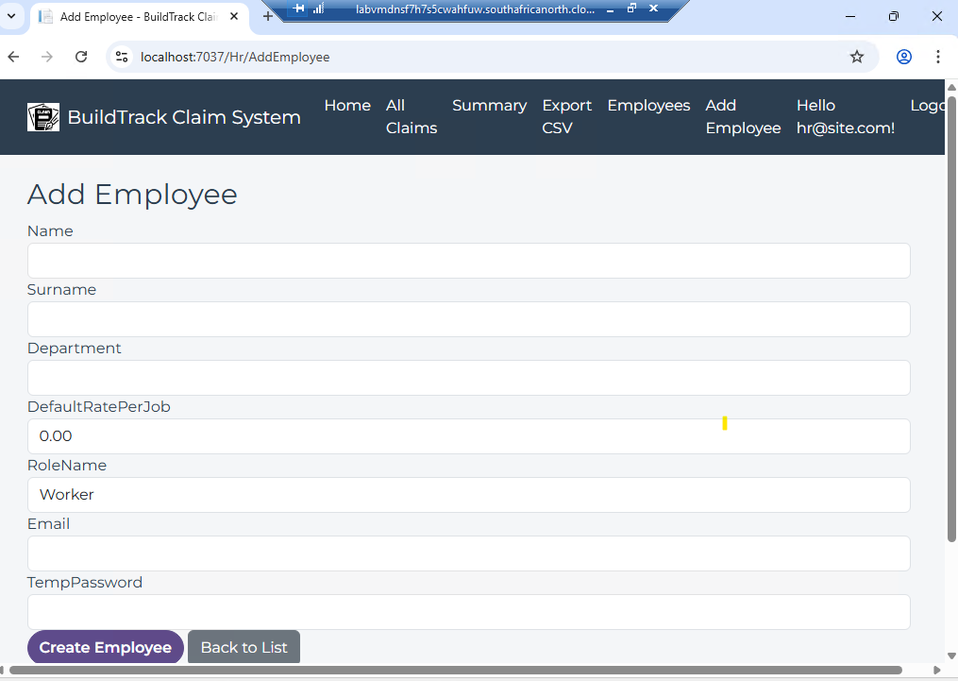
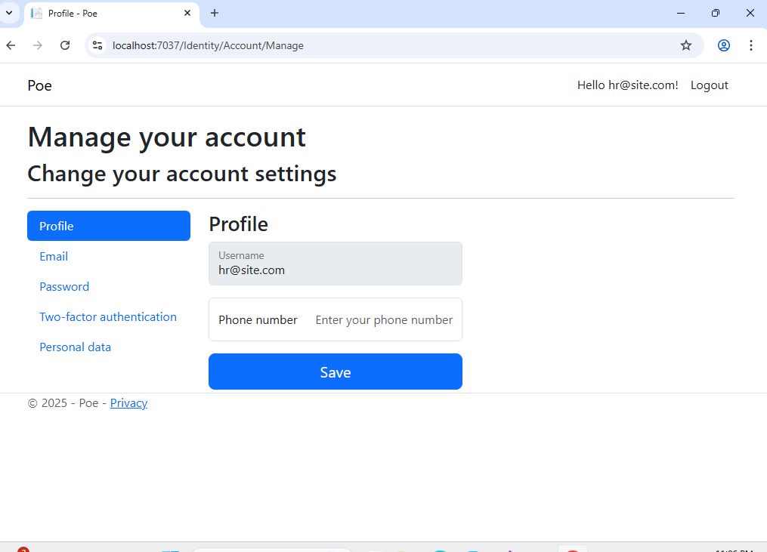
HR Feature
They can add Employees
Lastly the “Hello…” is authentication feature

Slide 16
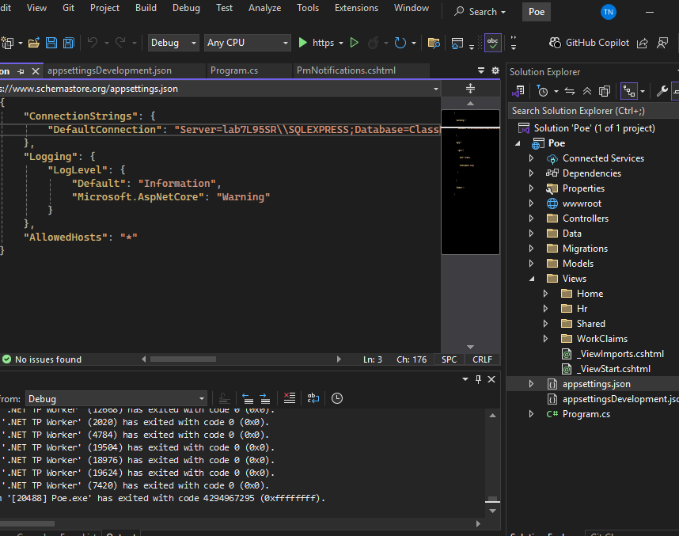
SQL Server Management Studio 20
In this application, SQL is used to store, manage, and retrieve all the data related to workers, claims, approvals, and payroll. Each user role like Worker, Project Manager, Construction Manager, and HR interacts with the database to submit, review, or process claims. By using SQL, the application can efficiently track claim statuses, enforce business rules (like reason-required rejections), calculate payments, and generate reports. This ensures data consistency, enables secure multi-user access, and provides the foundation for real-time workflows and automated notifications, making the claims process transparent and streamlined. Therefore I will provide a screenshot of the connection string

Slide 17
Conclusion
In conclusion, the BuildTrack Claim System successfully addresses the challenges associated with managing construction work claims by providing a structured, automated, and user-friendly platform. The application simplifies the process for Workers to submit claims and allows Managers and HR to review, approve, and finalize payments efficiently. With SQL-based data management, automated workflows, and clear reporting, the system enhances productivity, reduces errors, and ensures transparency across all roles. The project demonstrates the effectiveness of integrating web technologies and database management to solve real-world operational problems in construction project administration.

